Slide 1
Coursera Capstone Project
Battle of Neighborhoods
Author: Anoop Kohale, IBM

Slide 2
Business Problem
Business man wants to open a Bakery in the neighborhood of New York City.
He/She wants to analyze the existing Bakery business and provide an insight to the suitable location to open their business
The market analysis will provide a strategy and direction to the new business increasing their chances of success

Slide 3
Data used
The New York Neighborhood data provided by NYU
Foursquare Venues data
Foursquare Details of Venues
Geocoder data (Latitude and Longitude)

Slide 4
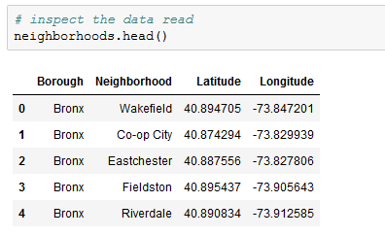
Methodology
Data acquisition and cleansing
The GeoJSON file provided by NYU contains information about the neighborhoods in New York
We extract Borough, Neighborhood, Latitude and Longitude from the file

Slide 5
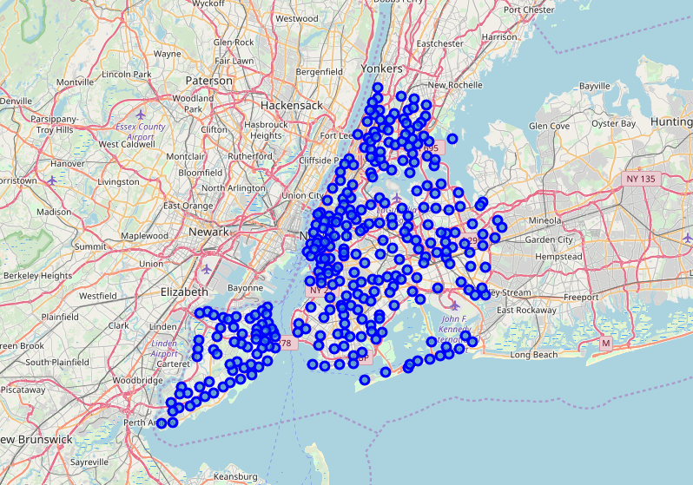
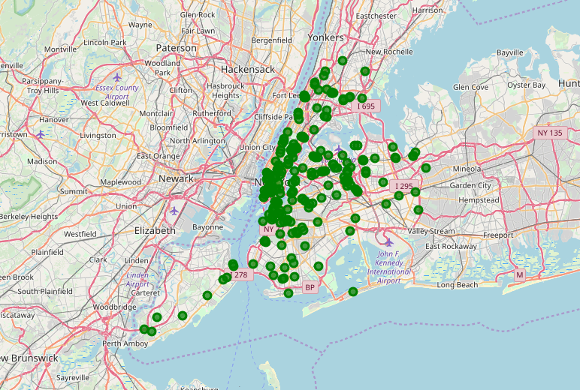
Data Visualization
Neighborhoods in New York
Bakeries in New York Neighborhoods

Slide 6
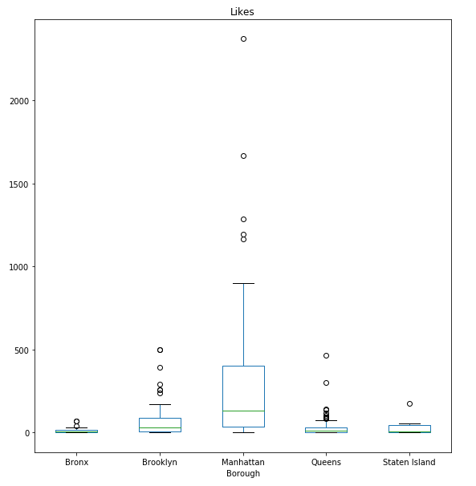
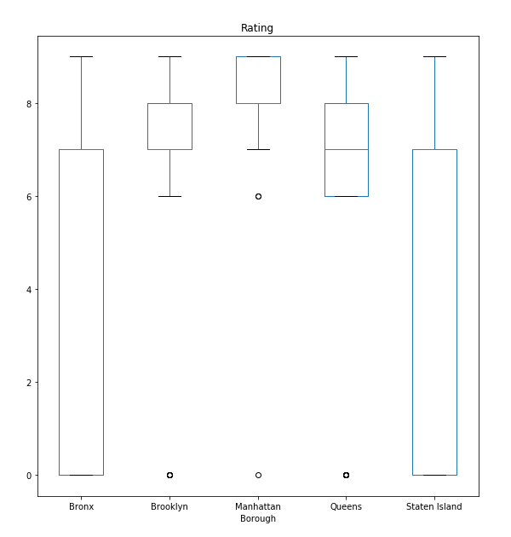
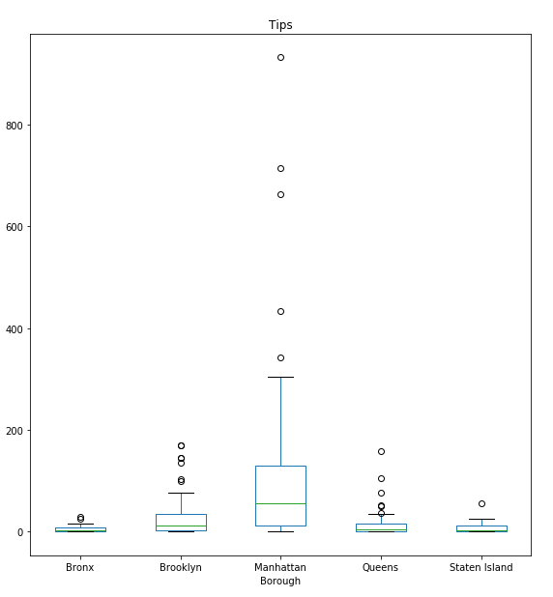
Box plots of Likes, Ratings and Tips of Bakeries from Foursquare

Slide 7
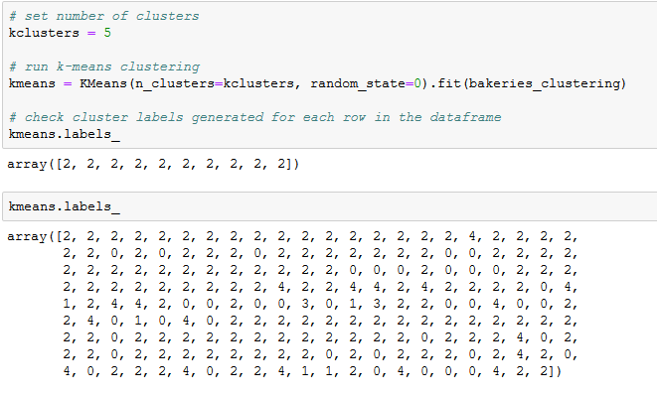
Clustering on the Bakeries data
Create clusters using the data gathered about Bakeries in New York

Slide 8
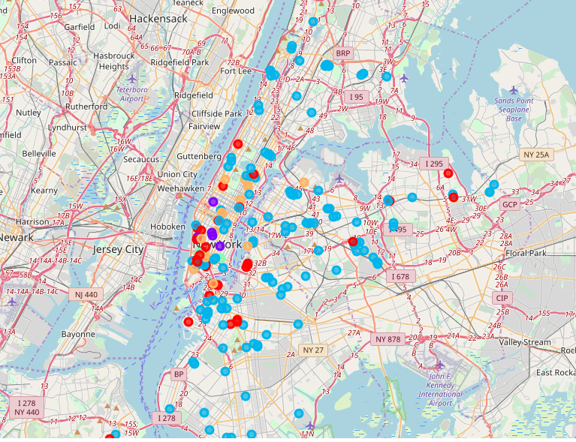
Folium Map of the various clusters of Bakeries based on Ratings, Likes and Tips

Slide 9
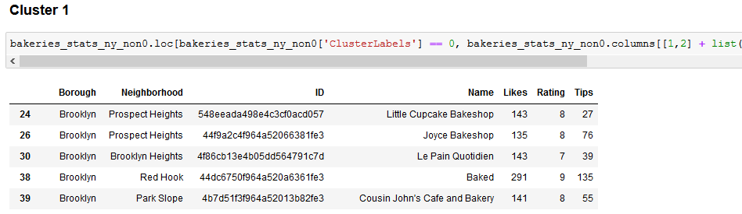
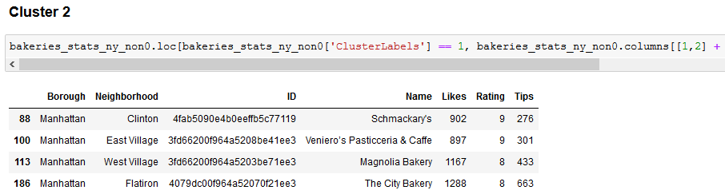
Some Glimpses of the clusters data

Slide 10
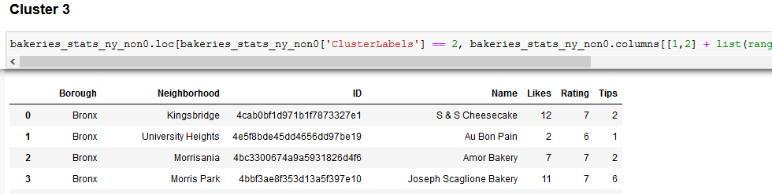
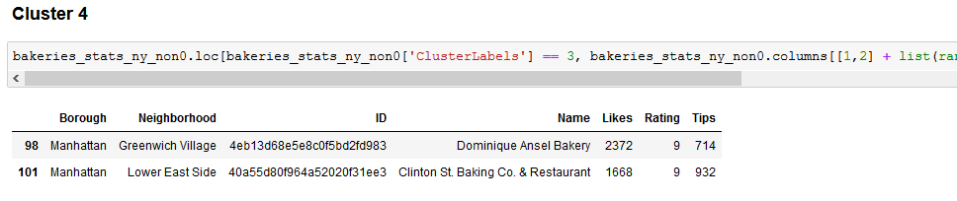
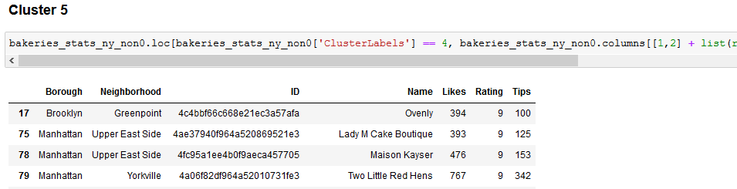

Slide 11
Result & Conclusion
Cluster 2 and Cluster 4 have the Bakeries with highest likes and ratings
Cluster 5 has moderate reviews
Cluster 3 has least reviews for the venues. This indicates that the outlets are not popular in these venues.
Cluster 1 provides venues with moderate reviews. This cluster is more spread over the city. The venue selection from this clueter will require further analysis

Slide 12
The exercise provides insights to the Bakeries business in New York city
The clustering divides the bakeries based on the Likes, Ratings and Tips from Foursquare
This provides a good starting point in the setting up of new bakery in New York City
We can combine the demographic data and real estate pricing data to come up with the favored neighborhood to start the business

